Slide 1
Pattern Recognition Questions and Answers
Andreas Maier
Lehrstuhl für Mustererkennung (Informatik 5),
Friedrich-Alexander-Universität Erlangen-Nürnberg, Germany

Slide 2

Popular Questions

Slide 3
How do I evaluate a classification system?

Slide 4
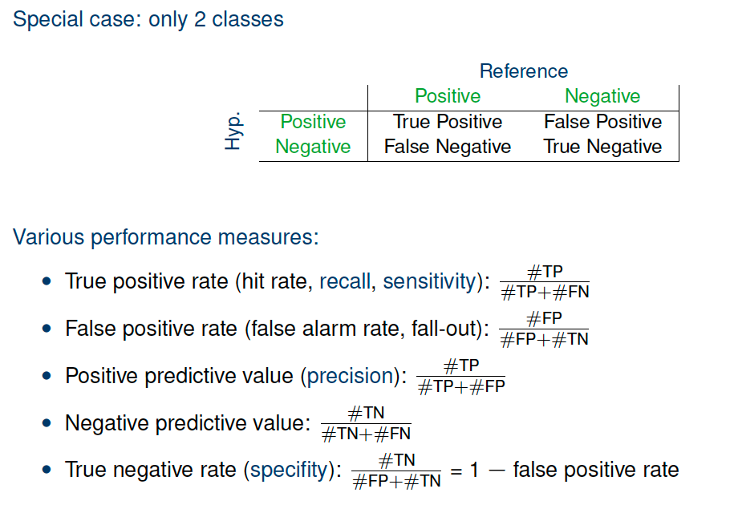
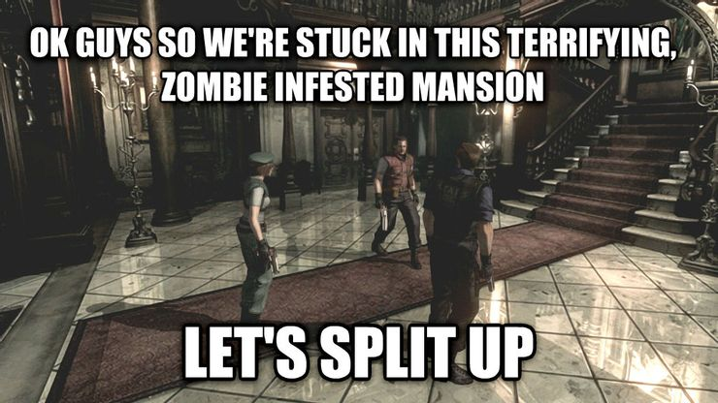




Example Zombie Disease!
Attribution: TM & © Universal (2004)
Attribution: TM & © Universal (2004)
Attribution: Phantom Open Emoji maintainers and contributors
Attribution: Twitter
True Negative
True Positive
False Positive
False Negative

Slide 5
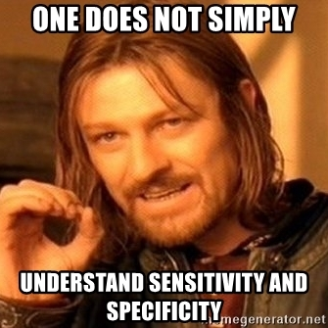
Performance Measures
Example:
C = P + N = 100,000
P = TP + FN = 10,000 (Prevalence 10%)
N = FP + TN = 90,000
TPR = 99.7% (Sensitivity)
TP = 10,000 * 99.7% = 9,970
FN = 30
TNR = 99.2% (Specificity)
TN = 90,000 * 99.2% = 89,280
FP = 720
9,970
720
30
89,280
100,000
10,000
90,000
/ Specificity

Slide 6
Performance Measures
Example: C = P + N = 100,000 P = TP + FN = 10,000 (Prevalence 10%) N = FP + TN = 90,000
TPR = 99.7% (Sensitivity) TP = 10,000 * 99.7% = 9,970 FN = 30
TNR = 99.2% (Specificity)
TN = 90,000 * 99.2% = 89,280
FP = 720
Attribution: TM & © Universal (2004)
Attribution: TM & © Universal (2004)
False Negative ~ Sensitivity (not sensitive to Zombies) 30 Cases!
False Positive ~ Specificity (not specific to Zombies) 720 Cases!

Slide 7
Performance Measures
Example: C = P + N = 100,000 P = TP + FN = 1,000 (Prevalence 1%) N = FP + TN = 99,000
TPR = 99.7% (Sensitivity) TP = 1,000 * 99.7% = 997 FN = 3
TNR = 99.2% (Specificity)
TN = 99,000 * 99.2% = 89.280
FP = 792
Attribution: TM & © Universal (2004)
Attribution: TM & © Universal (2004)
False Negative ~ Sensitivity (not sensitive to Zombies) 3 Cases!
False Positive ~ Specificity (not specific to Zombies) 792 Cases!

Slide 8
Performance Measures
Example: C = P + N = 100,000 P = TP + FN = 50,000 (Prevalence 50%) N = FP + TN = 50,000
TPR = 99.7% (Sensitivity) TP = 50,000 * 99.7% = 49,850 FN = 150
TNR = 99.2% (Specificity)
TN = 50,000 * 99.2% = 49,600
FP = 400
Attribution: TM & © Universal (2004)
Attribution: TM & © Universal (2004)
False Negative ~ Sensitivity (not sensitive to Zombies) 150 Cases!
False Positive ~ Specificity (not specific to Zombies) 400 Cases!

Slide 9
Performance Measures
Example: C = P + N = 100,000 P = TP + FN = 90,000 (Prevalence 90%) N = FP + TN = 10,000
TPR = 99.7% (Sensitivity) TP = 90,000 * 99.7% = 89,730 FN = 270
TNR = 99.2% (Specificity)
TN = 10,000 * 99.2% = 9,920
FP = 80
Attribution: TM & © Universal (2004)
Attribution: TM & © Universal (2004)
False Negative ~ Sensitivity (not sensitive to Zombies) 270 Cases!
False Positive ~ Specificity (not specific to Zombies) 80 Cases!

Slide 10
Performance Measures
Re-Test:
ON = TN + FN = 89,310
OP = TP + FP = 10,690
TPR = 99.7% (Sensitivity)
TP = 9,970 * 99.7% = 9,940
FN = 30
TNR = 99.2% (Specificity)
TN = 720 * 99.2% = 714
FP = 6
New TPR = 99.4%
New TNR = 99.99%
9,970
720
30
89,280
100,000
10,000
90,000
9,940
6
60
89,994
100,000
10,000
90,000

Slide 11
Performance Measures
Re-Test:
ON = TN + FN = 89,310
OP = TP + FP = 10,690
TPR = 99.7% (Sensitivity)
TP = 30 * 99.7% = 30
FN = 0
TNR = 99.2% (Specificity)
TN = 89,280 * 99.2% = 88,566
FP = 714
New TPR = 100%
New TNR = 98.4%
9,970
720
30
89,280
100,000
10,000
90,000
10,000
1,434
0
88,566
100,000
10,000
90,000

Slide 12
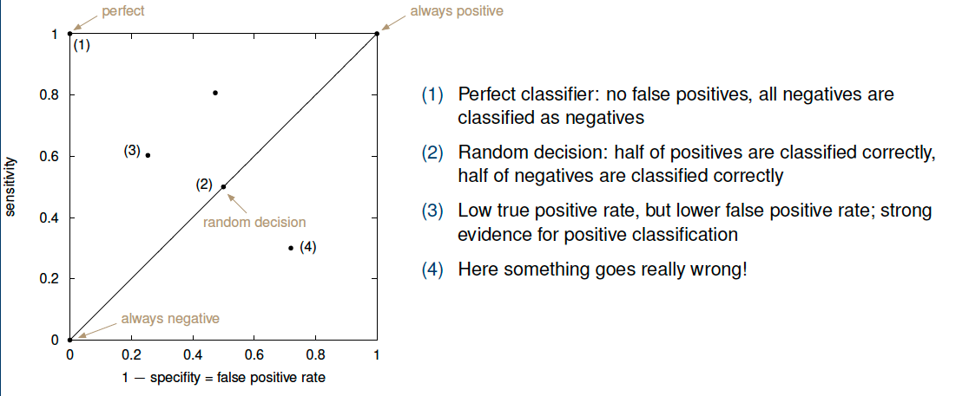
ROC (Receiver Operated Characteristic) Analysis
Vanilla Zombie Classifier
Positive Re-test Zombie Classifier
- specificity / false positive rate
Negative Re-test Zombie Classifier

Slide 13
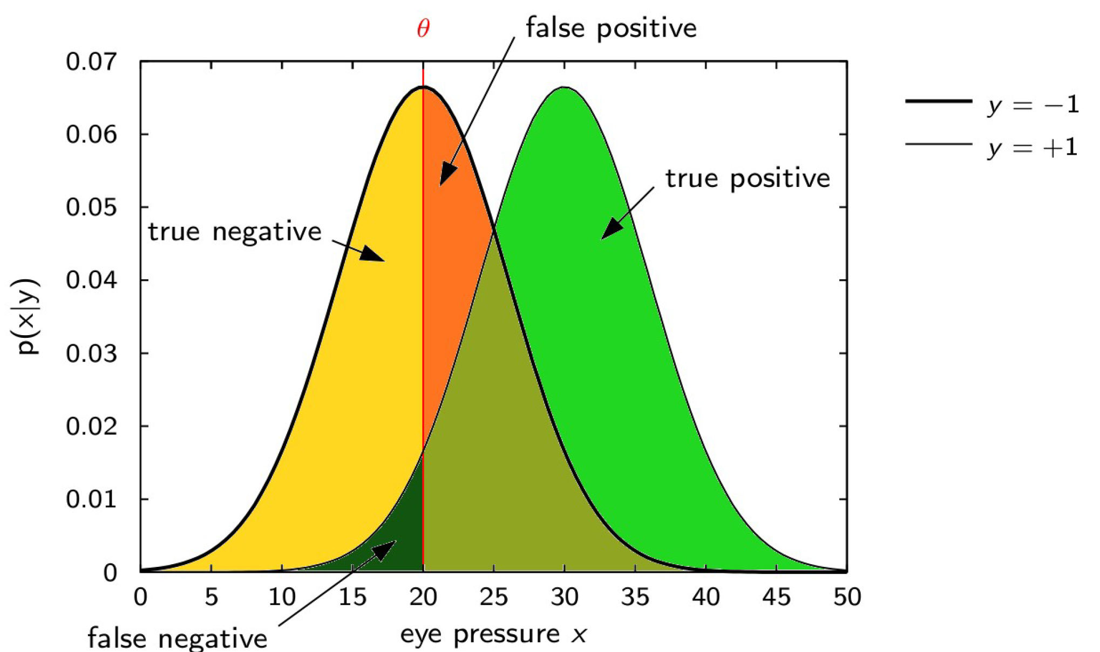
Tests are probabilistic!

Slide 14
How to deal with this?
- Adopt threshold according to scenario
Determine costs of wrong decisions
Change threshold according to prevalence
- Use more independent tests
Boosting, Bagging & Ensembles

Slide 15
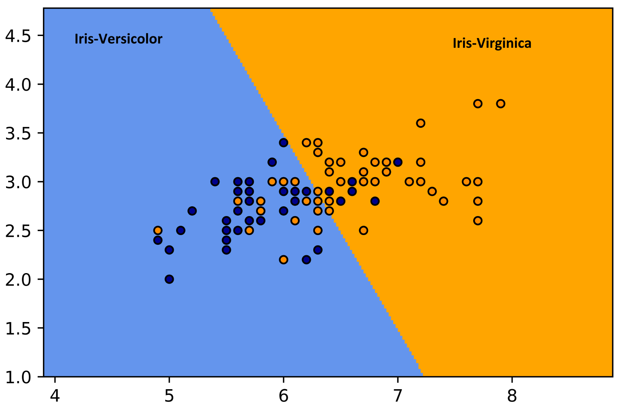
Boosting – Idea
Requires independent tests to work well!
Test 2
Test 1

Slide 16
Boosting – Problems
Low Correlation
=> Potentially high yield from muliple tests
Test 2
Decision Boundary
Test 1

Slide 17
Boosting – Problems
High Correlation
=> Not independent!
Test 2
Decision Boundary
Test 1

Slide 18
Boosting – Problems
Test 2
Relevant Area
Decision Boundary
Test 1

Slide 19
Boosting – Problems
Test 2
Relevant Area
Decision Boundary
Test 1

Slide 20
Exercise Problems
Vary specificity and sensitivity and check their impact on false positives and negatives
Try to find papers describing tests for other problems:
Credit card fraud (check prevalence!)
Social bots (check accuracy!)
Compute prevalence from sensitivity, specificity & observed positives and negatives

Slide 21
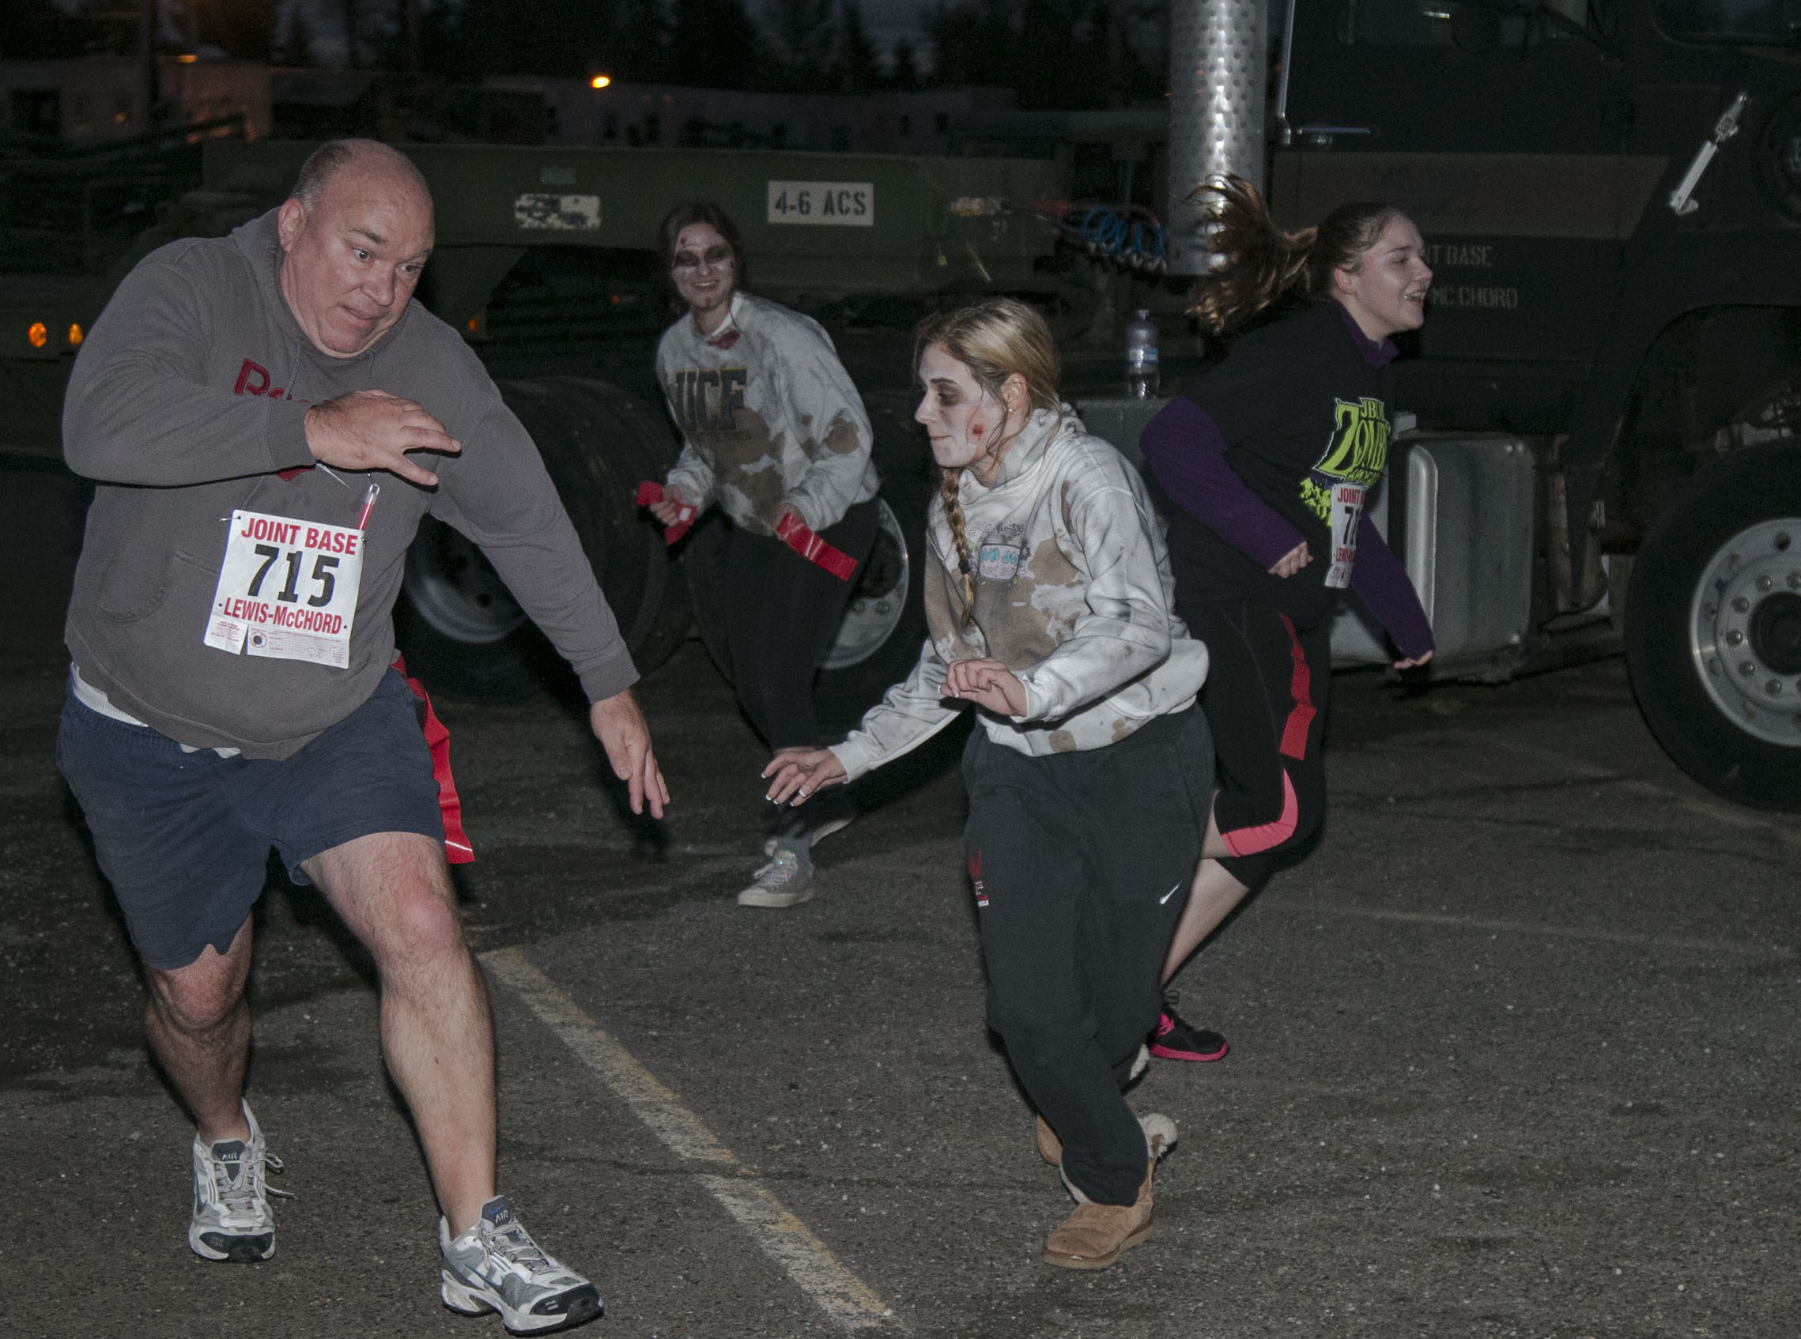

Stay safe and healthy!
Source: Wikimedia Commons

Slide 22

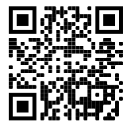

Thank you for your attention!
@ maier_ak
https://www.youtube.com/c/AndreasMaierTV/

